Slide 1
Trés Difficile
Tayana Vixama, RN
Christopher Roy, MD

Slide 2
Learning Objectives
By the end of this session,
you will be able to . . .
Recognize what types of stool will and will not be accepted by the laboratory.
Explain the Brigham priority of tiered-testing for C. difficile.
List the new treatment guidelines for C. difficile colitis.
Describe the treatment options for fulminant C. difficile, including fecal microbiota transplant (FMT).
Notes:
Speaker: Tayana

Slide 3
The Stick Test
Notes:
Speaker: Tayana

Slide 4
The Stick Test
A Short Poem
By Robin Rodriguez, MT (ASCP)
BWH Microbiology Lab
Notes:
Speaker: Tayana

Slide 5
The Stick Test
A Short Poem
By Robin Rodriguez,
BWH Microbiology Lab
A Short Poem
By Robin Rodriguez, MT (ASCP)
BWH Microbiology Lab
"If it ain't loose, it's no use."
Notes:
Speaker: Tayana

Slide 6
The Stick Test
A Short Poem
By Robin Rodriguez,
BWH Microbiology Lab
A Short Poem
By Robin Rodriguez, MT (ASCP)
BWH Microbiology Lab
"If it ain't loose, it's no use."
"If the stick stands, the test is banned."
Notes:
Speaker: Tayana

Slide 7
The Stick Test
A Short Poem
By Robin Rodriguez,
BWH Microbiology Lab
A Short Poem
By Robin Rodriguez, MT (ASCP)
BWH Microbiology Lab
"If it ain't loose, it's no use."
"If the stick stands, the test is banned."
"If the stick falls, test them all."
Notes:
Speaker: Tayana

Slide 8
Glutamate Dehydrogenase Test for C. Difficile: Steps

Slide 9
Glutamate Dehydrogenase Test for C. Difficile: Interpretation

Slide 10
Positive Antigen, Positive Toxin for C. Difficile by the Glutamate Dehydrogenase Testing

Slide 11
Diagnosing C. Difficile at Brigham and Women's Hospital
1. Loose or watery stool are tested by Glutamate Dehydrogenase assay.
2. 11:00 AM Cut-Off for same-day results.
3. 24 hours a day, 7 days for STAT specimens.
4. STAT testing takes 40 minutes.
5. Stool specimens are held for five days if Antigen +, but Toxin – in case additional testing (PCR) is ordered through Infectious Disease.
6. Rare stool that is Toxin + and Antigen – is called "Indeterminate." An automatic PCR or Nucleic Acid Amplification Testing (NAAT) is run by the microbiology laboratory.
A tiered-testing process
Notes:
Speaker: Tayana

Slide 12
Case
64-year-old male is admitted for elective cervical laminectomy. Perioperatively he receives a single dose of prophylactic cefazolin and develops fever, severe diarrhea, and abdominal distention on POD#3, WBC 7→26K. C. difficile is sent and is positive.
Notes:
Speaker: Chris

Slide 13
What is the best treatment regimen for this patient?:
a. Metronidazole 500 mg orally q8h
b. Fidaxomicin 200mg orally bid
c. Vancomycin 500 mg orally q6h
d. IVIG
e. Fecal Microbiota Transplant

Slide 14
What is the best treatment regimen for this patient?:
a. Metronidazole 500 mg orally q8h
b. Fidaxomicin 200mg orally bid
c. Vancomycin 500 mg orally q6h
d. IVIG
e. Fecal Microbiota Transplant

Slide 15
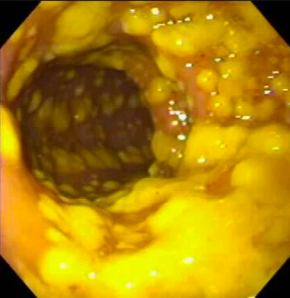
Notes:
Speaker: Chris

Slide 16
2017 Updated IDSA Guidelines for C diff
Fidaxomicin is recommended alternative to Vancomycin orally
Metronidazole is downgraded, and is only weakly recommended for mild disease if Fidaxomicin and Vancomycin are unavailable
Clin Infect Dis. 2018 Feb 15
Notes:
Speaker: Chris

Slide 17
Case (continued)
Patient is started on oral vancomycin 125mg q6 hours. Over the next few days his bowel movements decrease, but he has worsening abdominal distention and pain. He is tachycardic and febrile, and WBC rises to 36K. You order a KUB.
Notes:
Speaker: Chris

Slide 18
KUB of the Abdomen
Case courtesy of Dr Derek Smith, Radiopaedia.org, rID: 31329
Notes:
Speaker: Chris

Slide 19
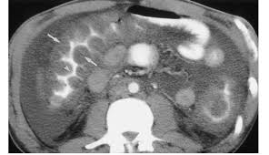
Severe Submucosal Edema C. difficile Colitis
Clostridium difficile Infection in Adults and Children, University of Michigan, Guidelines for Clinical Care
Notes:
Speaker: Chris

Slide 20
What is your next step?
a. Increase vancomycin to 250 mg q6 hours
b. Add IV metronidazole 250 mg q8 hours
c. Add IV vancomycin and cefepime
d. Consult ID, GI, and General Surgery
e. Place a rectal tube for instillation of vancomycin
f. Stat Fecal Microbiota Transplant

Slide 21
What is your next step?
a. Increase vancomycin to 250 mg q6 hours
b. Add IV metronidazole 250 mg q8 hours
c. Add IV vancomycin and cefepime
d. Consult ID, GI, and General Surgery
e. Place a rectal tube for instillation of vancomycin
f. Stat Fecal Microbiota Transplant

Slide 22
Fulminant/Severe C. difficile colitis Why consult experts?
Infectious Disease consultants will make sure you are maximizing medical therapy and provide guidance for relapsing C. difficile.
Surgery— discuss colectomy or alternatives, safety of rectal tube and volume of rectal vancomycin enema that is safe.
Gastroenterology—consider fecal microbiota transplant (FMT).
Notes:
Speaker: Chris

Slide 23
Fecal Microbiota Transplant (FMT)
C. difficile Colitis as a Deficiency of Normal Gut Flora
Stool transplants may be most effective Rx for relapsing C. difficile (“brown standard”?)
80-90% cure rates in patients with multiple relapses (vs 20-30% conventional therapy)
Less likely to have antibiotic-resistant gut flora
Britton and Young, Trends Microbiol 2012; NEJM 2013;368:407-15; Clin Infect Dis 2016;62:1479-86
Notes:
Speaker: Chris

Slide 24
Fecal Microbiota Transplant: How it’s done
Screen donor for HIV, viral hepatitis, stool pathogens, MDRO
Fresh feces (ideally day of procedure)
Refrigerate if needed, don’t freeze or heat
OpenBiome stool bank in Medford, MA offers fresh and freeze-dried encapsulated stool
Homogenize with preservative-free non-bacteriostatic saline in patient-provided blender
Chocolate malted milk shake consistency
Notes:
Speaker: Chris

Slide 25
Oral Encapsulated vs Colonoscopic Stool Transplant
116 patients in an unblinded randomized trial of stool transplant, either:
Colonoscopy (360 mL fecal slurry), or
40 capsules swallowed under direct observation (!)
Cure rates 96.2% in each arm at 12 weeks post-transplant
Capsule group more likely to view their experience as “not at all unpleasant” (66%, vs 44% in the colonoscopy arm)
JAMA 2017;318:1985-93
Notes:
Speaker: Chris

Slide 26
FMT for Fulminant Colitis at BWH
Can be considered in all but the most unstable/moribund patients prior to going to the operating room for colectomy
Observational data suggest high success rates
BWH Protocol Inclusion Criteria:
Patients with fulminant CDI confirmed by toxin EIA or PCR.
Failure of maximal medical therapy for 72 hours.
Aliment Pharmacol Ther 2015; 42: 470–476
Notes:
Speaker: Chris

Slide 27
Case
Despite treatment with high dose vancomycin 500mg orally q6 hours, rectal vancomycin via rectal tube, IV flagyl, and aggressive volume resuscitation, he continues to worsen with WBC 72K and hypotension requiring pressors. He goes emergently to the OR and is found to have severe colitis with areas of necrosis and perforation as well as frank peritonitis with stool in the abdomen.
Notes:
Speaker: Chris

Slide 28
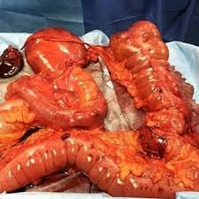
Colectomy Specimen:
Fulminant
C. Difficile Colitis
Our patient had a subtotal colectomy and end ileostomy performed. His pathology showed diffuse colitis with pseudomembranes and transmural ischemia/necrosis with perforation.​
Notes:
Speaker: Chris

Slide 29
Case
His subsequent course is notable for respiratory failure/ARDS requiring trach/PEG, multiple intraabdominal fluid collections requiring drainage, DVT/PE, and ESRD requiring HD. He is eventually discharged to long term care facility after 45 days in the hospital.
Notes:
Speaker: Chris

Slide 30
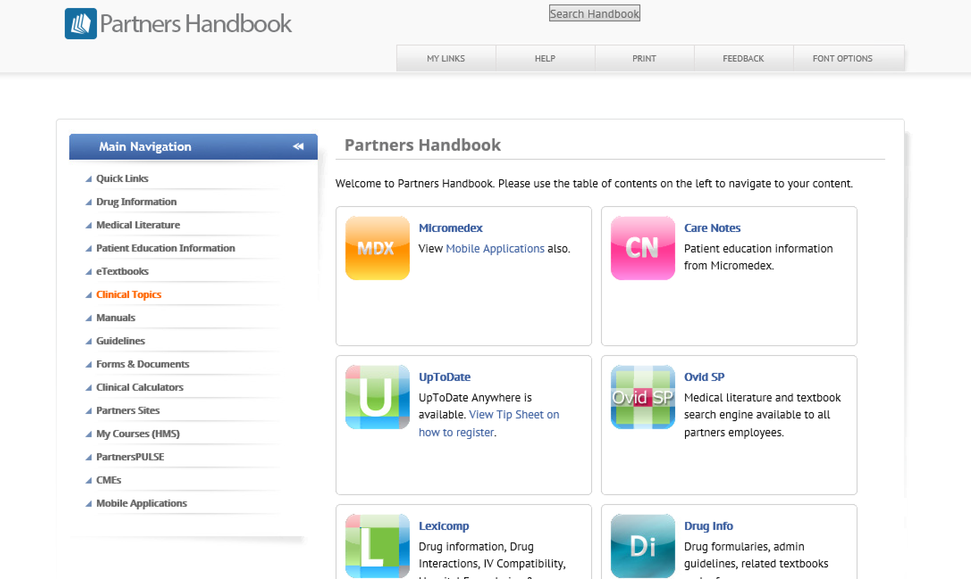
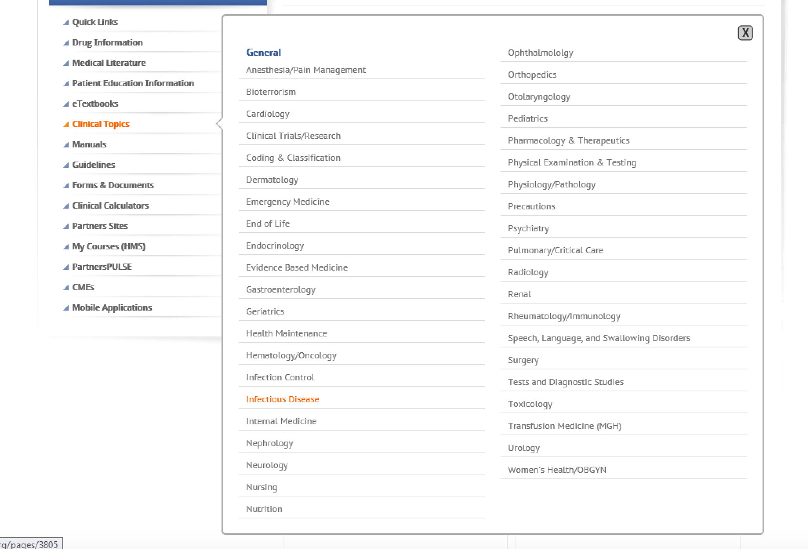
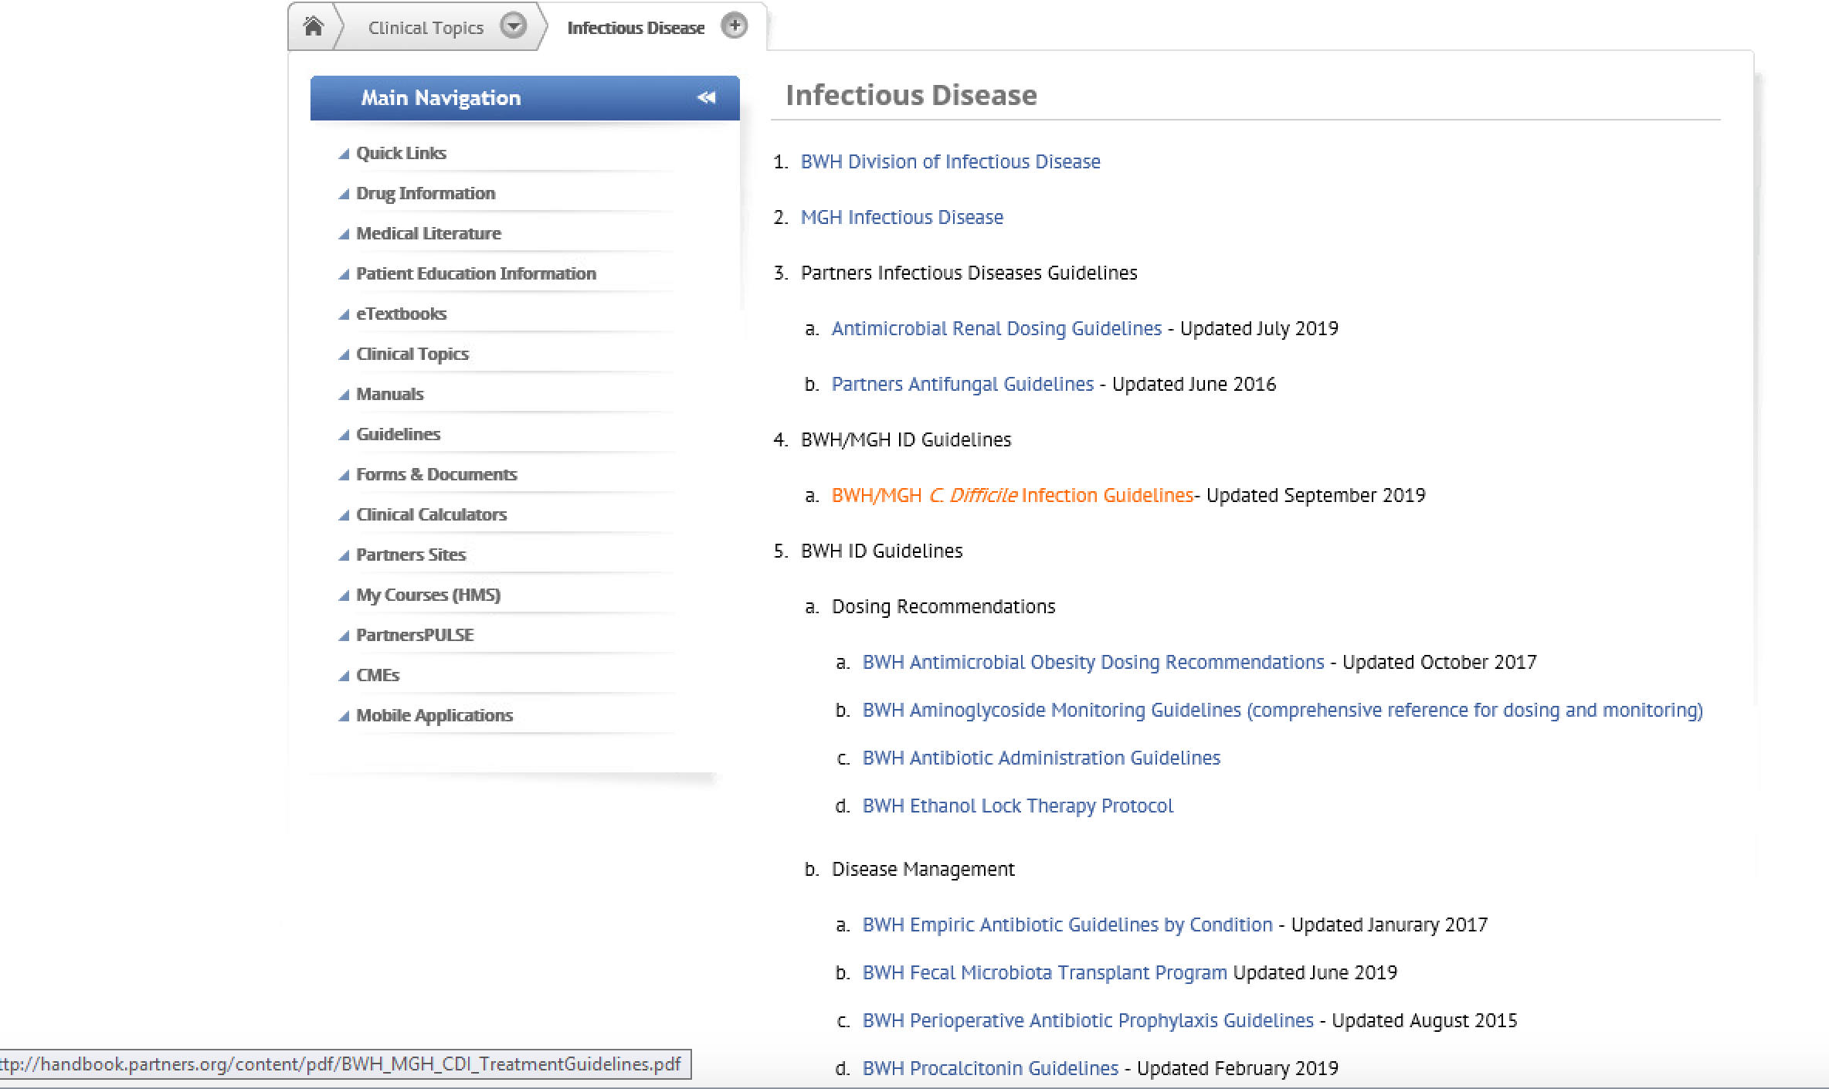
Where can I find C. difficile guidelines?

Slide 31
Trés Difficile: Diagnosis and Treatment of C. Diff
Tayana Vixama, RN & Chris Roy, MD
Stool must be loose or watery to pass the stick test!
Stool must be received by 11AM for same day testing!
STAT testing is available 24/7 and takes 40 minutes
team work
appreciation
BWH tiered-testing process
1. Glutamate Dehydrogenase
Test
listening
If Antigen +, but Toxin – additional PCR can be ordered through Infectious Disease if high clinical suscpicion
If Toxin + and Antigen – is "Indeterminate" and PCR will automatically be run on the sample.
collegiality
2. PCR or Nucleic Acid Amplification Testing (NAAT)
2017 Updated IDSA Guidelines for C diff Treatment
interprofessional
mutual respect
When it's fulminant you need the consultants!
1. Infectious Disease
2. Surgery
3. Gastroenterology
Transplanted stool is pretty cool!
Fecal Microbiota Transplant (FMT) may be most effective Rx for relapsing C. difficile
80-90% cure rates in patients with multiple relapses
understanding
patient care
communication
learning together
collaboration
Produced by Emily Piper-Vallillo, M.Ed., Marina Zambrotta, M.D., and Helen Shields, M.D.

